Slide 1
IBM BOB PESENTATION
Project Name:- Team Name:- | Mission Readiness & Predictive Maintenance Copilot Tech Titans

Slide 2
What problem? Who has it? Why does it matter?
Problem:
Aircraft, vehicles, and mission-critical equipment generate large volumes of sensor and operational data. Detecting abnormal behaviour early is difficult when relying mainly on manual monitoring or fixed maintenance schedules.
Who has it?
Who faces this problem?
Defence & aerospace organizations managing mission-critical aircraft
Maintenance engineers and technicians responsible for equipment health
Fleet operators managing multiple vehicles or aircraft
Mission planners who need to know whether equipment is ready for deployment
Why does it matter?
It matters because an unexpected component failure can cause:
Mission failure or operational downtime
Safety risks
Higher maintenance costs
Unnecessary replacement of healthy components
Delays in mission deployment

Slide 3
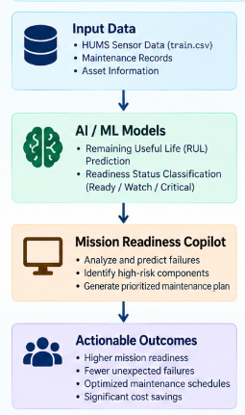
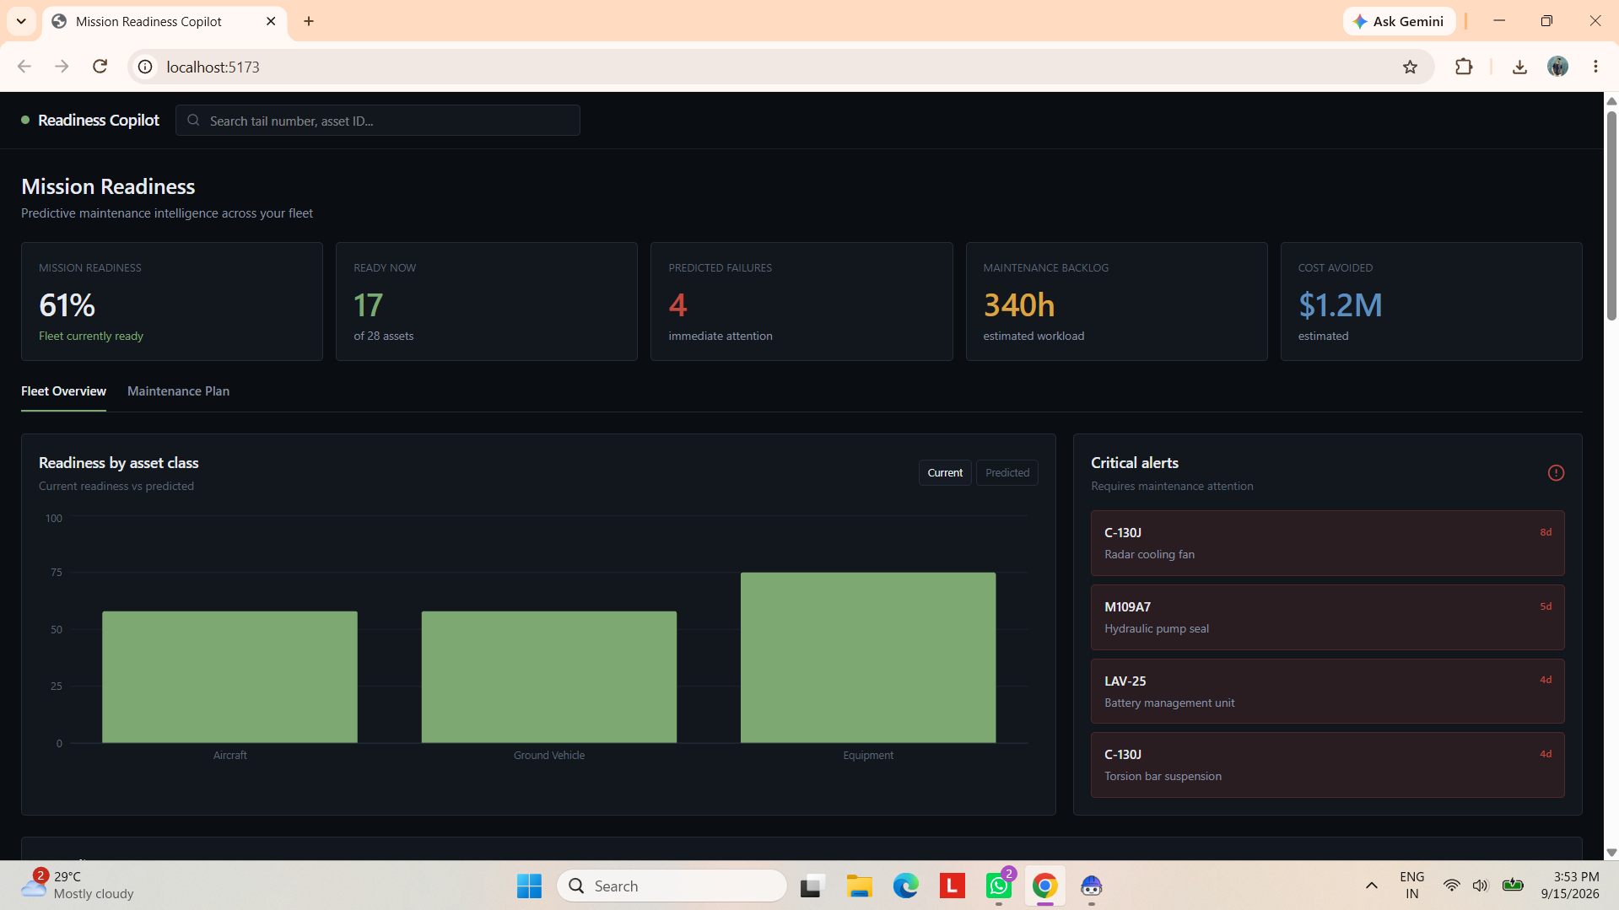
Diagram

Slide 4
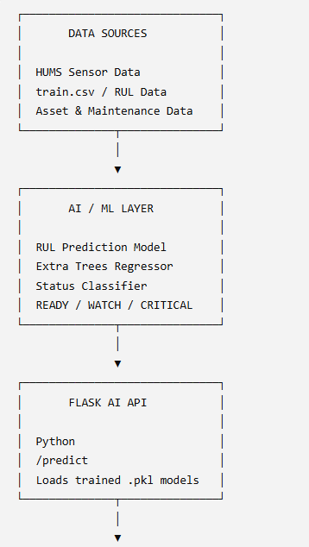
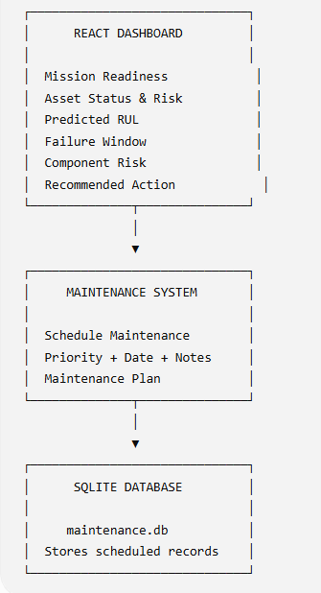
Architecture :-

Slide 5
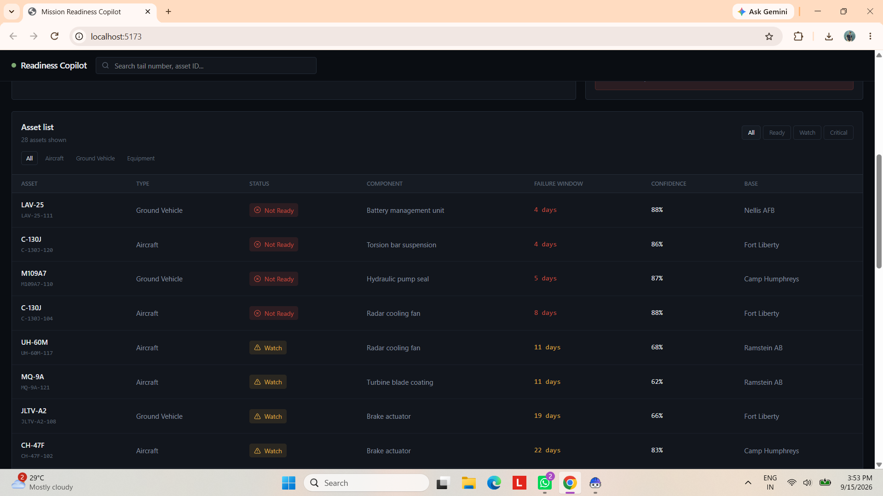
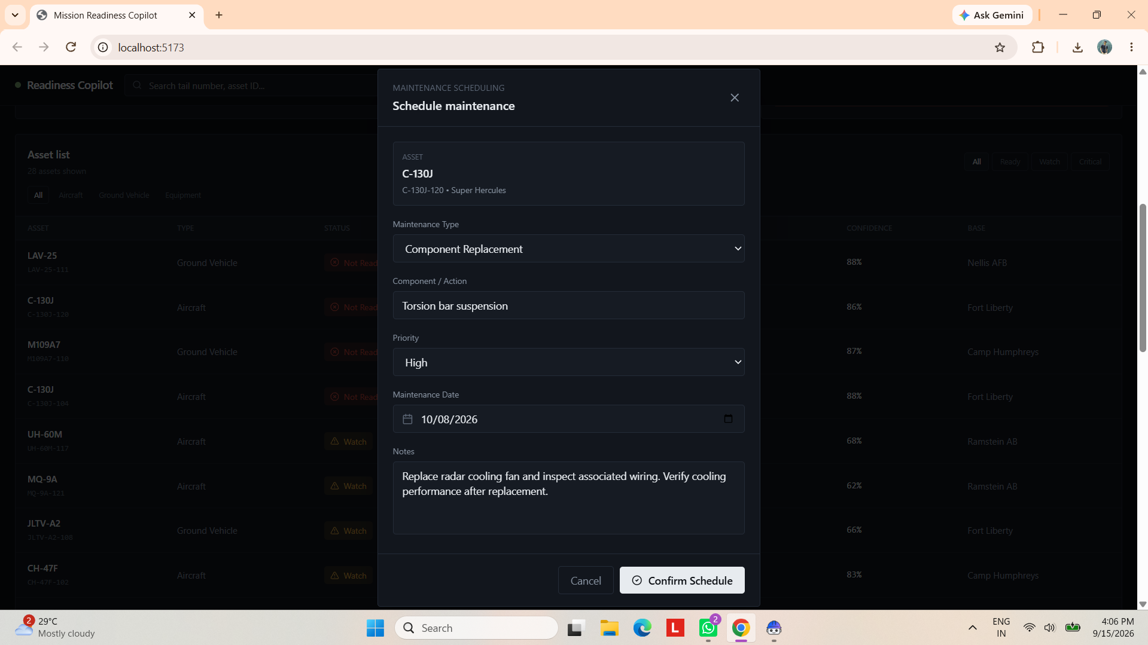
Demo

Slide 6
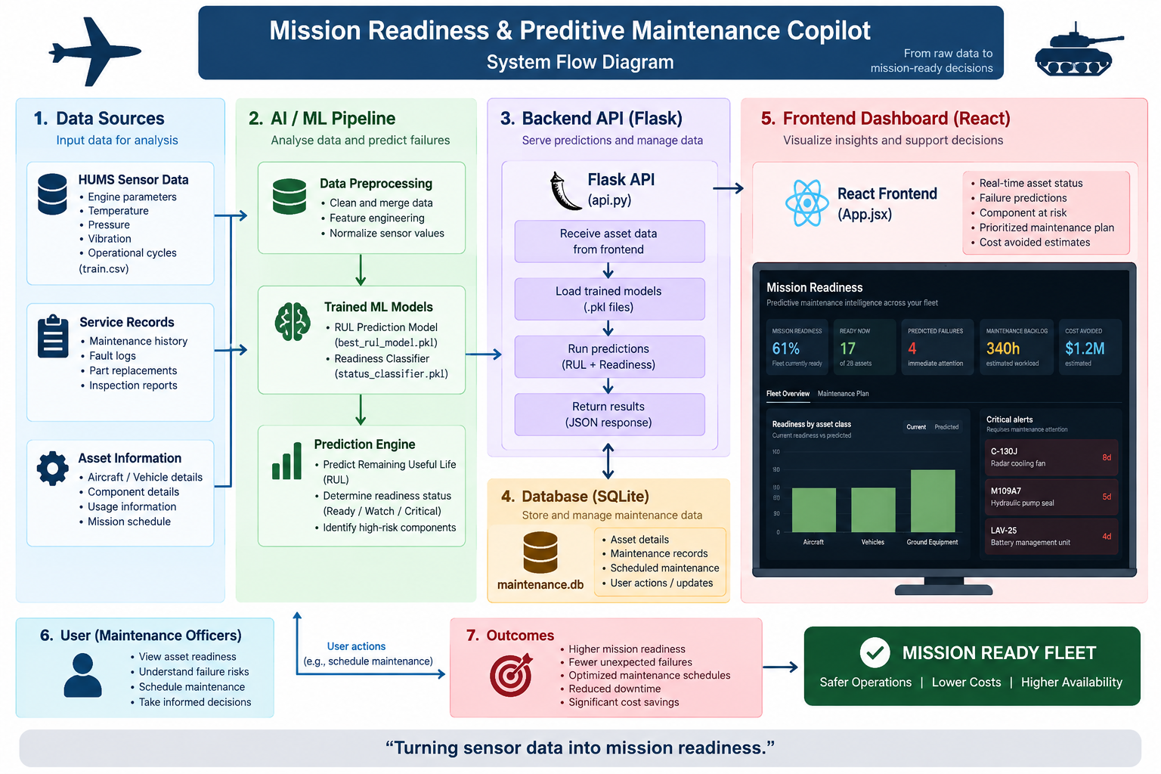
Full project working image

Slide 7
Results / Impacts
92.97% status-classification accuracy.
9.54 cycles MAE for RUL prediction.
Predicts READY / WATCH / CRITICAL conditions.
Identifies high-risk assets and components.
Enables earlier maintenance decisions before failure.
Supports prioritized maintenance scheduling.
Helps reduce unexpected downtime and maintenance cost.
Dashboard provides a single view of fleet readiness.

Slide 8
Team Members With their Roles
Solanki Dharma k. - Python / Presentation
Patel Jeel N. - React.js
Majithiya Aditya M. - SQLite
Tala Vinit V. - React.js

